Slide 1
PHY2505 Midterm
王浩哲 522072910008

Slide 2
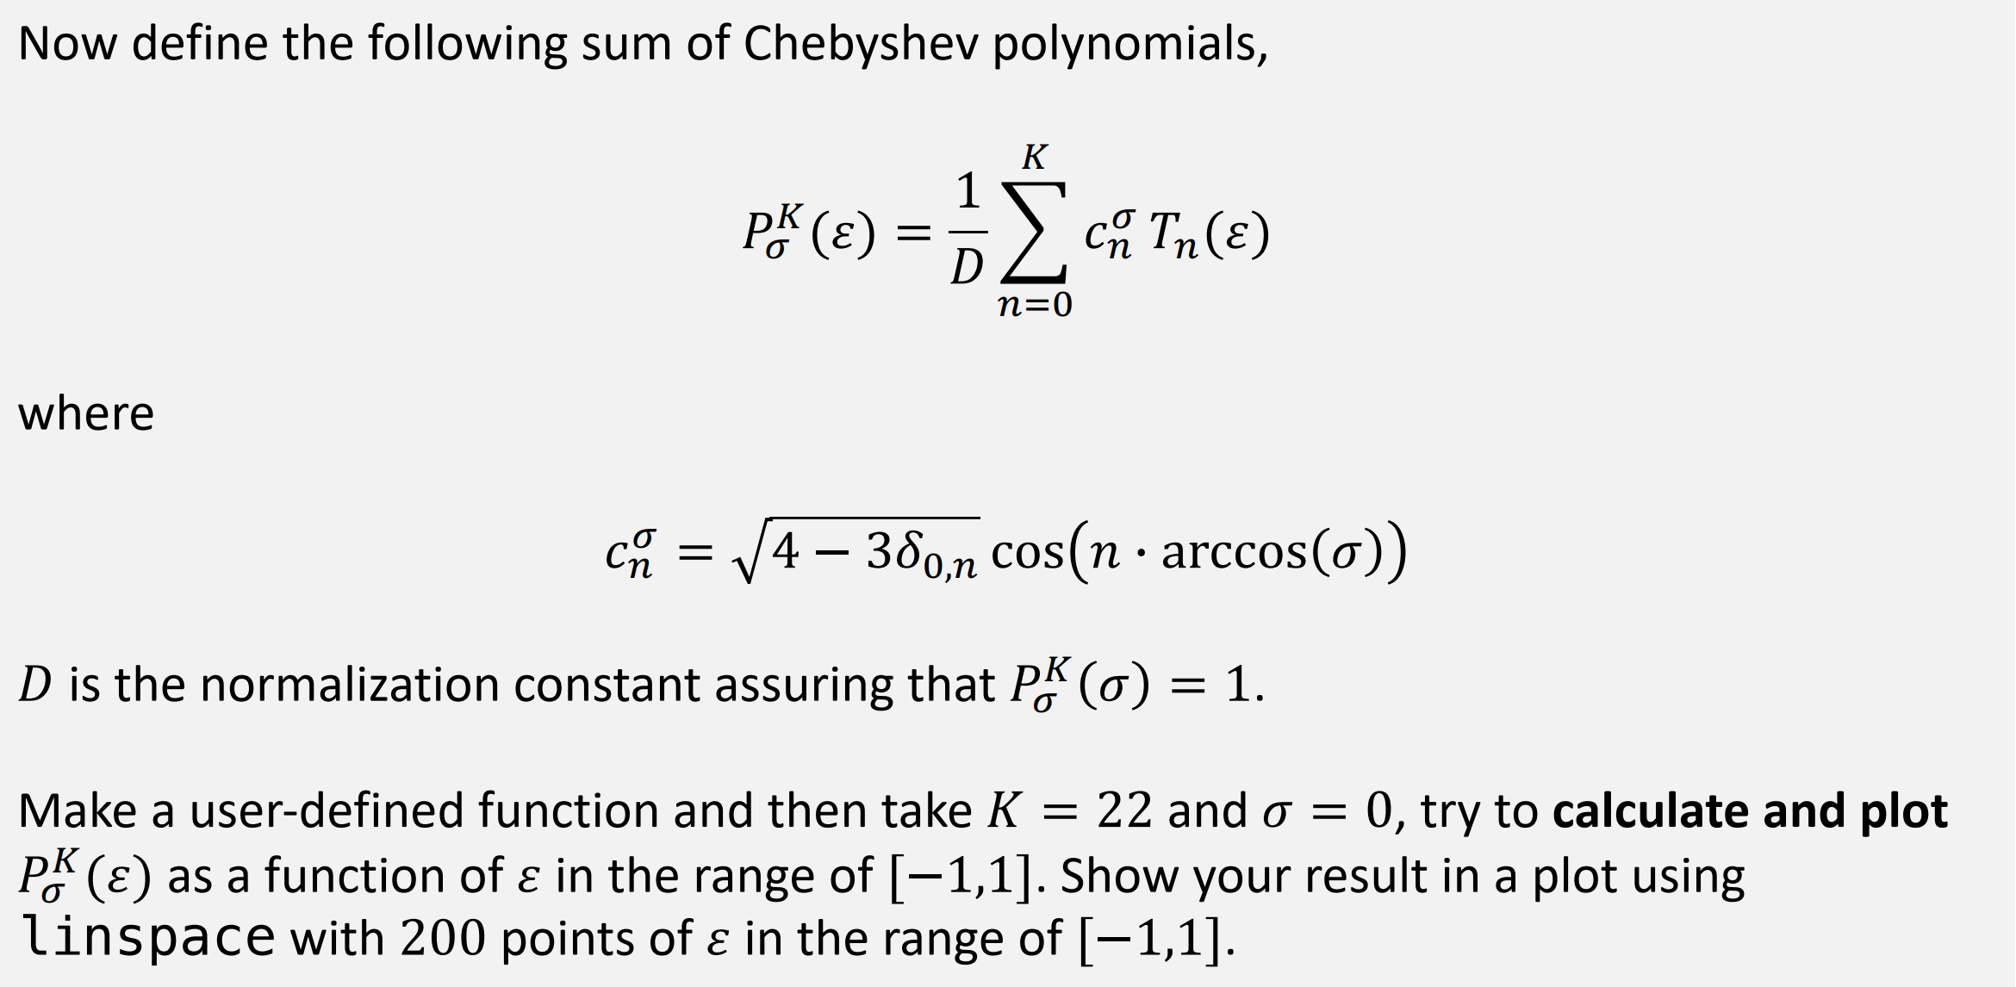

Problem 1 .1

Slide 3
Problem 1 .1 Code
import numpy as np from matplotlib import pyplot as plt def chebyshev_t(n, x): return np.cos(n * np.arccos(x)) def chebyshev_sum(sigma_, k_, epsilon_): """ Calculate the linear combination of Chebyshev polynomials :param sigma_: A constant parameter for the Chebyshev polynomials sum. :param k_: An integer represents the order of the Chebyshev polynomials sum :param epsilon_: An array of variables :return: The sum of the Chebyshev polynomials """ sum_ = np.ones(epsilon_.shape[0]) # n=0 for i in range(1, k_ + 1): sum_ += 2 * np.cos(i * np.arccos(sigma_)) * chebyshev_t(i, epsilon_) return sum_ def chebyshev_sum_norm(sigma_, k_, epsilon_): p_ = chebyshev_sum(sigma_, k_, epsilon_) norm_ = chebyshev_sum(sigma_, k_, np.array([sigma_])) return p_ / norm_ if __name__ == '__main__': e = np.linspace(-1, 1, 200) y = chebyshev_sum_norm(0, 22, e) plt.plot(e, y) plt.show()

Slide 4
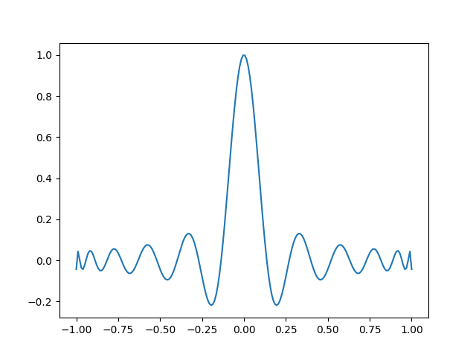
Problem 1 .1 Result

Slide 5
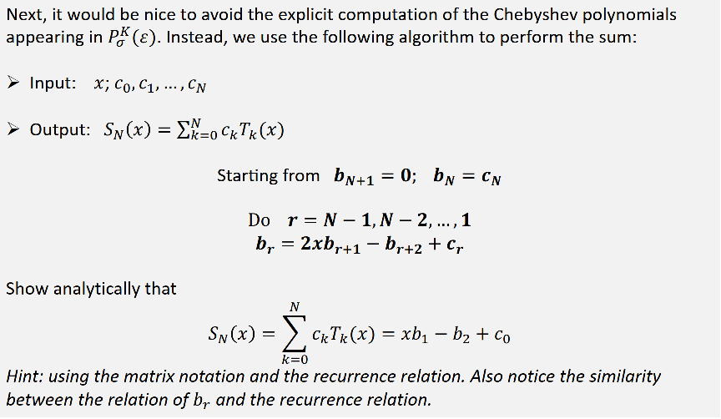
Problem 1 .2

Slide 6
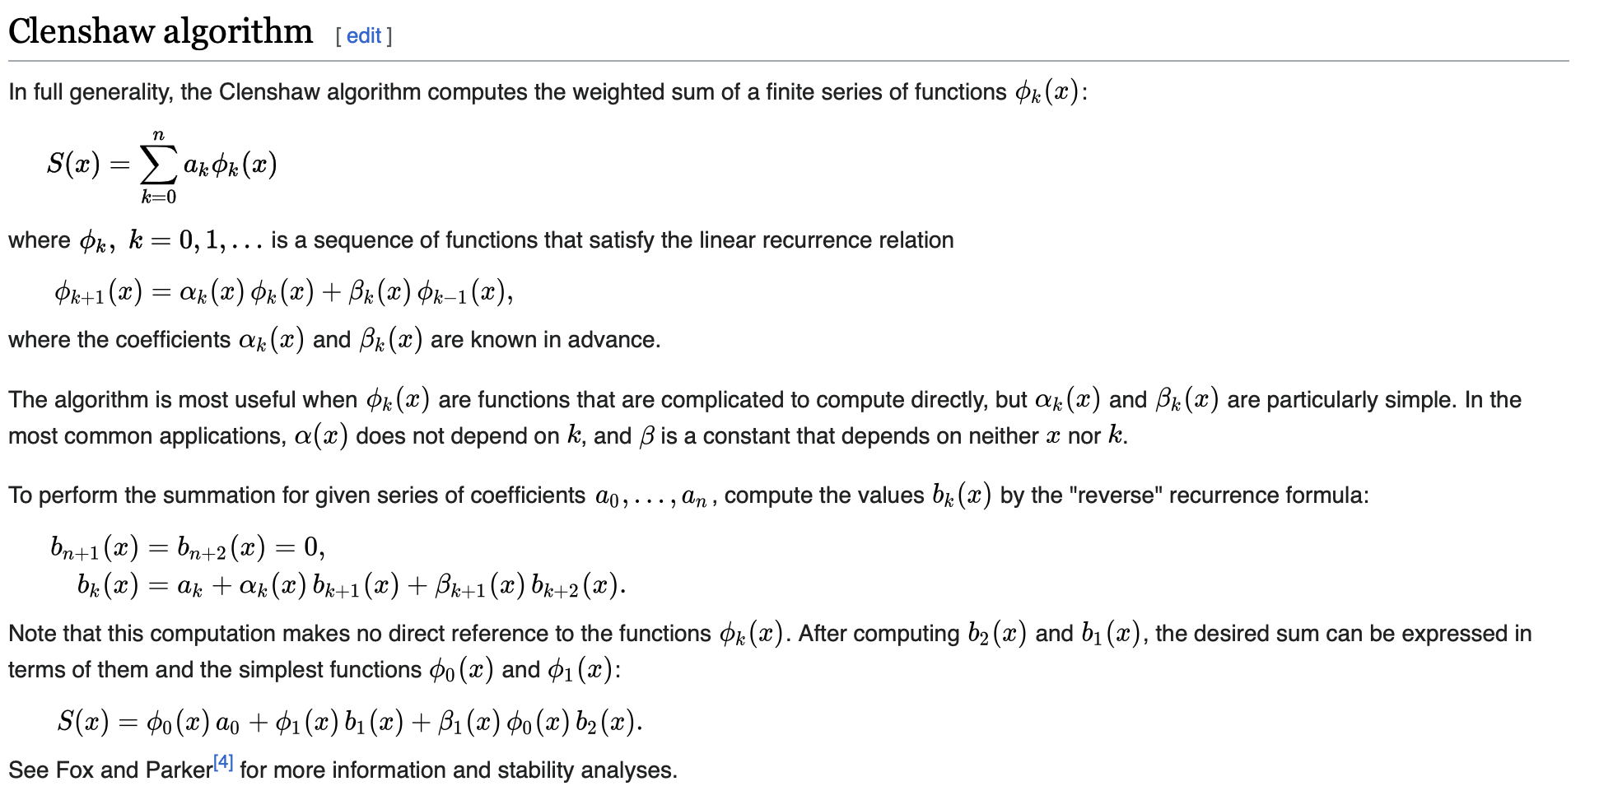
Problem 1 .2

Slide 7
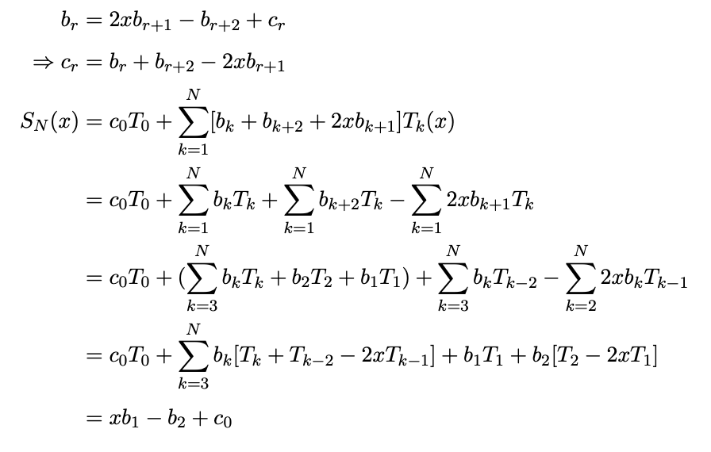
Problem 1 .2

Slide 8
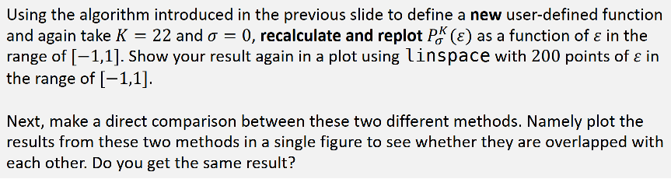
Problem 1 .3

Slide 9
Problem 1 .3 Code
import numpy as np from matplotlib import pyplot as plt from mid_prob_1_1 import chebyshev_sum_norm def find_c(k_, sigma_): c_ = np.zeros(k_ + 1) c_[0] = 1 for i in range(1, k_ + 1): c_[i] = 2 * np.cos(i * np.arccos(sigma_)) return c_ def chebyshev_sum_pref(sigma_, k_, epsilon_): """ Calculate the linear combination of Chebyshev polynomials based on the Clenshaw algorithm. :param sigma_: A constant parameter for the Chebyshev polynomials sum. :param k_: An integer represents the order of the Chebyshev polynomials sum :param epsilon_: An array of variables :return: The sum of the Chebyshev polynomials """ c_ = find_c(k_, sigma_) N_ = c_.shape[0] - 1 b_ = np.zeros((N_ + 1, epsilon_.shape[0])) b_[N_].fill(0) b_[N_ - 1].fill(c_[N_]) for i in range(N_ - 1, 0, -1): b_[i - 1] = 2 * epsilon_ * b_[i] - b_[i + 1] + c_[i] # Operate to the whole array return epsilon_ * b_[0] - b_[1] + c_[0]

Slide 10
Problem 1 .3 Code
def chebyshev_sum_pref_norm(sigma_, k_, epsilon_): p_ = chebyshev_sum_pref(sigma_, k_, epsilon_) norm_ = chebyshev_sum_pref(sigma_, k_, np.array([sigma_])) return p_ / norm_ if __name__ == '__main__': e = np.linspace(-1, 1, 200) plt.plot(e, chebyshev_sum_pref_norm(0, 22, e), color="#ff7f0e", label="New", marker=".") plt.plot(e, chebyshev_sum_norm(0, 22, e), color="#1f77b4", label="Old") plt.legend() plt.show()

Slide 11
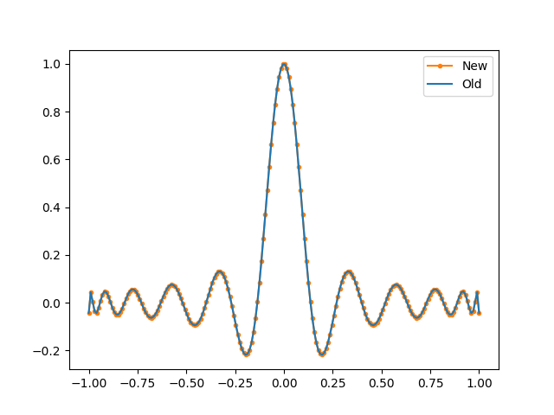
Problem 1 .3 Result

Slide 12
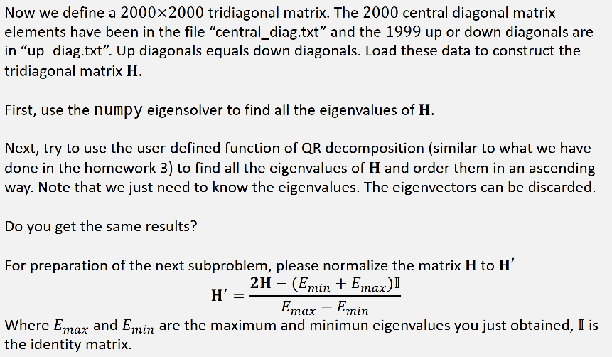
Problem 1 .4

Slide 13
Problem 1 .4 Code
import numpy as np import banded def qreigen(A, num): for i in range(num): v = np.diag(A) q, r = banded.qr_decomposition(A) A = np.dot(r, q) tol = max(np.diag(A)) - max(v) if np.abs(tol) < 1e-6: break return np.diag(A) if __name__ == '__main__': central_diag = np.loadtxt("central_diag.txt", float) up_diag = np.loadtxt("up_diag.txt", float) H = np.diag(central_diag) + np.diag(up_diag, k=1) + np.diag(up_diag, k=-1) sol = np.linalg.eigvals(H) sol.sort() print(sol) s = qreigen(H, 200) s = np.sort(s) print(s)

Slide 14
Problem 1 .4 Code
banded.py
import numpy as np def qr_decomposition(A): """ QR decomposition of a tridiagonal matrix A. :param A: a tridiagonal matrix. :return: the result of the decomposition. i.e Q, R. """ if A.shape[0] != A.shape[1]: raise ValueError('Input Matrix must be square') # Error handle dimension = A.shape[0] A_ = np.copy(A) # Separate the following operations from the original matrix A Q_ = np.zeros_like(A_) # Initialize Q R_ = np.zeros_like(A_) # Initialize R for i in range(dimension): # Gram-Schmidt orthogonality u_ = np.copy(A_[:, i]) for j in range(i): dot = 0 # Only calculate the non-zero elements if i != 0 and i != dimension - 1: for k in range(3): dot += Q_[i - 1 + k, j] * A_[i - 1 + k, i] # For the first and the last columns, there are only two non-zero elements elif i == 0: for k in range(2): dot += Q_[k, j] * A_[k, i] elif i == dimension - 1: for k in range(2): dot += Q_[dimension - 1 - k, j] * A_[dimension - 1 - k, i] u_ -= dot * Q_[:, j] Q_[:, i] = u_ / np.linalg.norm(u_)

Slide 15
Problem 1 .4 Code
banded.py
# Get R R_[i, i] = np.linalg.norm(u_) for j in range(i): dot = 0 if i != 0 and i != dimension - 1: for k in range(3): dot += Q_[i - 1 + k, j] * A_[i - 1 + k, i] elif i == 0: for k in range(2): dot += Q_[k, j] * A_[k, i] elif i == dimension - 1: for k in range(2): dot += Q_[dimension - 1 - k, j] * A_[dimension - 1 - k, i] R_[j, i] = dot return Q_, R_

Slide 16
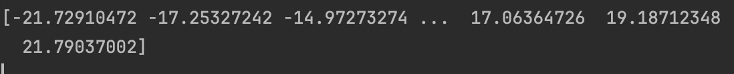

Problem 1 .4 Result
banded.qr_decomposition():
numpy.linalg.eigvals():
The difference between the two results may be due to too few iterations

Slide 17
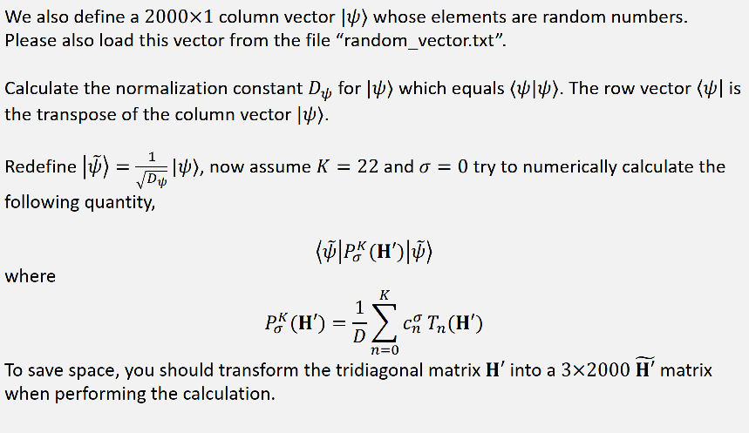
Problem 1 .5

Slide 18
Problem 1 .5 Code
import numpy as np def find_c(k_, sigma_): c_ = np.zeros(k_ + 1) c_[0] = 1 for i in range(1, k_ + 1): c_[i] = 2 * np.cos(i * np.arccos(sigma_)) return c_ def chebyshev_polynomial(A, n): """ Chebyshev polynomial of a matrix A. :param A: a square matrix. :param n: the order of the Chebyshev polynomial. :return: the Chebyshev polynomial result of A. """ I = np.eye(A.shape[0]) if n == 0: return I elif n == 1: return A else: T_n_minus_2 = I T_n_minus_1 = A for _ in range(n - 1): T_n = 2 * A.dot(T_n_minus_1) - T_n_minus_2 T_n_minus_2, T_n_minus_1 = T_n_minus_1, T_n return T_n print(result)

Slide 19
Problem 1 .5 Code
def chebyshev_sum(sigma_, k_, epsilon_): c_ = find_c(k_, sigma_) sum_ = 0 for i in range(k_ + 1): sum_ += c_[i] * chebyshev_polynomial(epsilon_, i) return sum_ if __name__ == '__main__': psi = np.loadtxt('random_vector.txt', float) central_diag = np.loadtxt("central_diag.txt", float) up_diag = np.loadtxt("up_diag.txt", float) # Construct and normalize H H = scipy.sparse.diags([up_diag, central_diag, up_diag], [-1, 0, 1]) e_max = 21.79048303 e_min = -21.79048303 H_normalized = (2 * H - (e_max + e_min) * np.eye(H.shape[0])) / (e_max - e_min) # Calculate the normalization constant D P_norm = chebyshev_sum(0, 22, np.array([0])) P = chebyshev_sum(0, 22, H_normalized) / P_norm # Calculate the normalized psi psi_normalized = psi / np.sqrt(np.dot(psi, psi)) # Calculate the final result result = np.dot(psi_normalized.T, np.dot(P, psi_normalized)) print(result)
Result:0.07096450778976128

